Slide 1












COD-A-FESTX 2.0
Sandeep Kumar
Sakshi Wadhwa
Sahil Kumar
Vasil Akhtar
TEAM ID - 53
Team Name-
Tech-Titans

Slide 2





Problem Statement
Idea Board
Electra Blockchain
INDEX
Overview
How it Works
Technical Architecture
Conclusion

Slide 3




PROBLEM STATEMENT -
Design and implement a secure voting platform using blockchain technology , with a focus on creating an intuitive and visually appealing web interface using HTML and CSS the platform should allow users to cast their votes securely, with each vote being recorded on a blockchain ,ensuring transparency and trust in the election process.

Slide 4


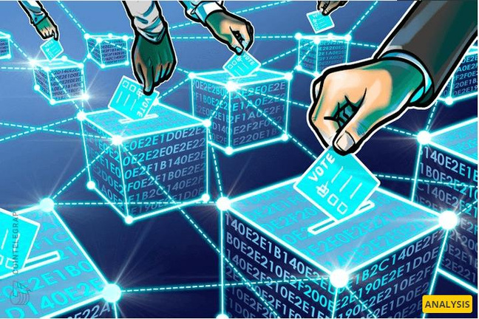


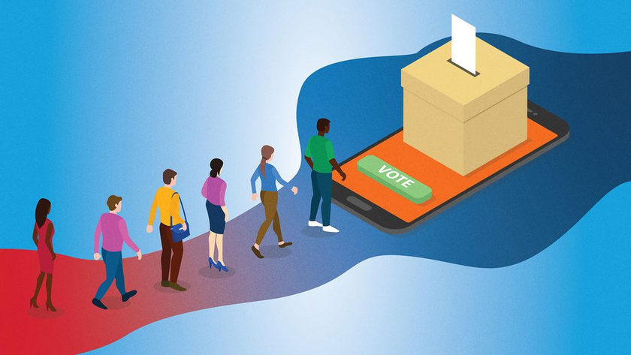

Idea Board
SECURE VOTING PLATFORM

Slide 5



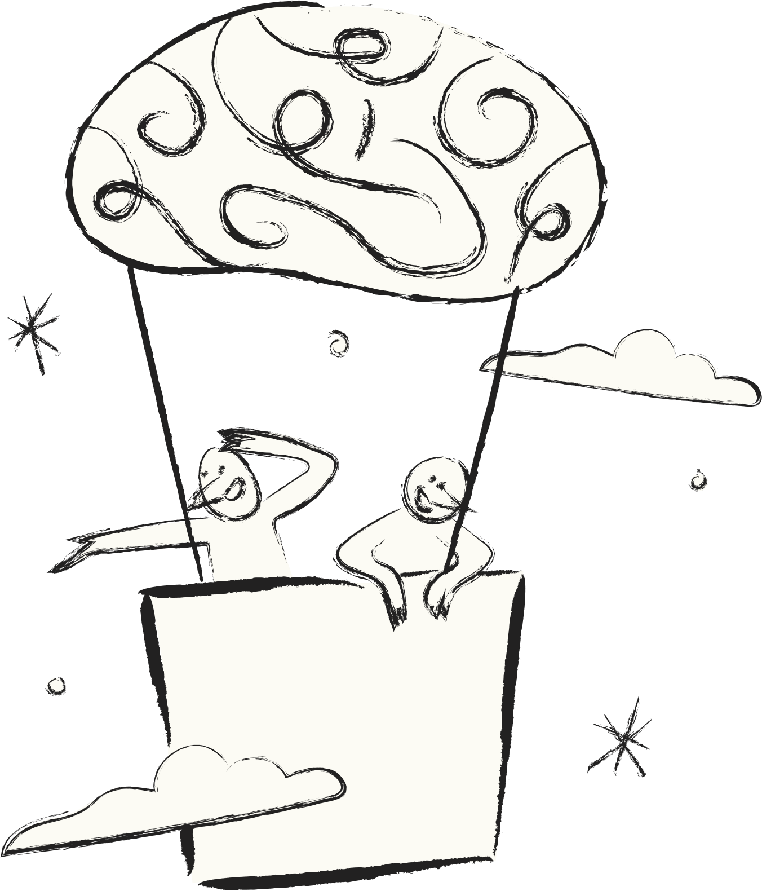



Electra: Blockchain-Based Voting Platform

Slide 6




Electra is a state-of-the-art blockchain-based voting platform designed to ensure transparency, security, and efficiency in the voting process. By leveraging blockchain technology, Electra aims to create a tamper-proof and auditable system for conducting elections, whether they are political, organizational, or institutional.
Overview

Slide 7
Blockchain Integration
Security Measures
Transparency and Auditing
1
2
3
Decentralization: Electra uses a decentralized ledger provided by blockchain technology to record votes. This decentralization minimizes the risk of tampering or fraud, as there is no single point of failure.
Immutable Records: Once a vote is recorded on the blockchain, it cannot be altered or deleted. This ensures the integrity and permanence of each vote cast.
Smart Contracts: Smart contracts automate the voting process, including voter registration, vote casting, and result tallying, ensuring that all rules are followed strictly and transparently.
Encryption: All data transmitted between users and the platform is encrypted using HTTPS to protect against eavesdropping and data breaches.
Authentication: Secure authentication methods, such as multi-factor authentication and blockchain-based digital signatures, ensure that only authorized voters can participate.
Privacy: Voter privacy is protected through anonymization techniques, ensuring that individual votes cannot be traced back to voters.
Real-Time Results: Votes are recorded in real-time on the blockchain, allowing for immediate and transparent tallying of results.
Audit Trail: The blockchain provides a complete audit trail of all voting activities, enabling verification and validation of the election process.

Slide 8


How It Works
Voter Registration:
Voters register on the Electra platform by providing their credentials and verifying their identity through secure methods.
Once verified, voters are issued a digital token or credential on the blockchain that authorizes them to vote.
Casting Votes:
Voters log in to the platform and select their preferred candidates or options.
The vote is submitted through a secure transaction that is recorded on the blockchain.
Vote Tallying:
Votes are automatically tallied by smart contracts once they are recorded on the blockchain.
Results are updated in real-time and are available for verification by authorized parties.
Result Verification:
The complete voting history and results are accessible on the blockchain for auditing purposes.
Independent auditors can verify the results by examining the blockchain ledger.

Slide 9



1
Blockchain Network:
Platform: Ethereum or a similar blockchain with smart contract capabilities.
Features: Immutable ledger, decentralized consensus, and secure data storage.
2
Database
Smart Contracts:
Voting Contract: Manages the election process, including candidate registration, vote casting, and tallying.
Voter Registration Contract: Handles voter authentication and ensures each voter can only vote once..
Technical Architecture
Web3.JS
3
Frontend:
Technology: HTML, CSS, and JavaScript (with libraries like Web3.js or ethers.js).
Features: User-friendly interface for selecting candidates, casting votes, and viewing results.
html
javasript
node.js
css
4
Backend:
Node.js: For handling backend logic and interacting with the blockchain.
Database: Optional for additional data storage, such as historical election data.

Slide 10




Electra aims to revolutionize the voting process by leveraging blockchain technology to ensure a secure, transparent, and user-friendly electoral system. By following this proposed solution, Electra will provide a reliable platform for conducting elections and referendums, reinforcing trust in the democratic process.
Conclusion

Slide 11

THANKYOU

